Slide 1


Tanishq Jewellery: Smart SaaS
& Data Science Ecosystem
Tanishq Insights Cloud

Slide 2

01
Introduction & Context
Overview
02
DS & ML
03
SaaS Productization
04
Business Impact
05
Conclusion

Slide 3

1. Introduction & Context
Tanishq, India’s largest jewelry retailer, continues to operate in a highly dynamic market shaped by festivals, weddings, shifting consumer behavior, and volatile global gold prices.
While Tanishq has adopted advanced tools like Oracle ERP, WebAR Try-On, MoEngage personalization, and conversational AI, critical gaps remain in areas such as real-time supply chain optimization, dynamic pricing, and predictive customer loyalty modeling.
Modern customers demand hyper-personalized experiences, instant transparency, and omni-channel convenience, expecting brands to predict their needs before they even ask.
Reliance on traditional decision-making methods leads to risks like dead stock, missed sales opportunities, long queues during festive rush, and limited insights from in-store traffic
Data Science & Machine Learning can bridge these gaps—through predictive analytics, computer vision, voice AI, and intelligent demand forecasting—to future-proof Tanishq’s operations.
By deploying SaaS-based AI platforms, Tanishq can scale innovation quickly, integrate with existing ERP, CRM, and digital platforms, and achieve agility without heavy infrastructure costs.
This transformation positions Tanishq not just as a jewelry brand, but as a data-driven, AI-enabled luxury retailer setting global benchmarks in efficiency, personalization, and customer trust.

Slide 4

2. Data Science & ML
Predictive Supply Chain Optimization – AI/ML models for demand clustering, restocking, and supplier forecasting to reduce dead stock and shortages.
AI Virtual Stylist – AR-powered personal shopper recommending jewelry sets based on occasion, budget, and purchase history.
Dynamic Pricing Engine – Reinforcement learning models adapting to gold prices, competitor pricing, and demand elasticity.
Smart In-Store Video Analytics – Computer vision to analyze footfall, dwell time, and product heatmaps for store optimization.
Voice-Powered Assistance – Multilingual Voice AI (Hindi, Tamil, Bengali, English) for website, app, and kiosks.
AI Loyalty & CLV Prediction – ML models predicting churn, lifetime value, and personalizing loyalty offers.
Seasonal & Festival Demand Forecasting – LSTM/Prophet forecasting to anticipate festive/wedding peaks.
Store Performance Benchmarking – AI dashboards comparing store KPIs across regions and predicting underperformers.
Geo-Intelligence Expansion – AI clustering to plan new store locations and run hyperlocal festive marketing campaigns.

Slide 5
Inventory Management
Problem : Overstock/understock due to demand fluctuation.
Solution : Demand forecasting (Prophet, LSTM) + stock optimization.
SaaS Offering : Forecasting API integrated with ERP.
Impact : Lower inventory cost, higher availability.
Summary :
    Our SaaS uses advanced forecasting models to analyze regional demand trends and automate stock distribution. By predicting store-level requirements, Tanishq can avoid excess inventory costs while ensuring products are available during peak shopping periods. This prevents revenue leakage, improves efficiency, and builds customer trust through consistent product availability.

Slide 6
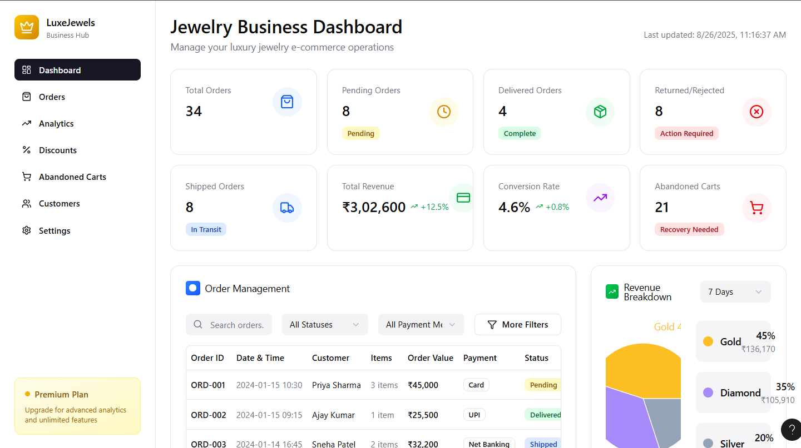
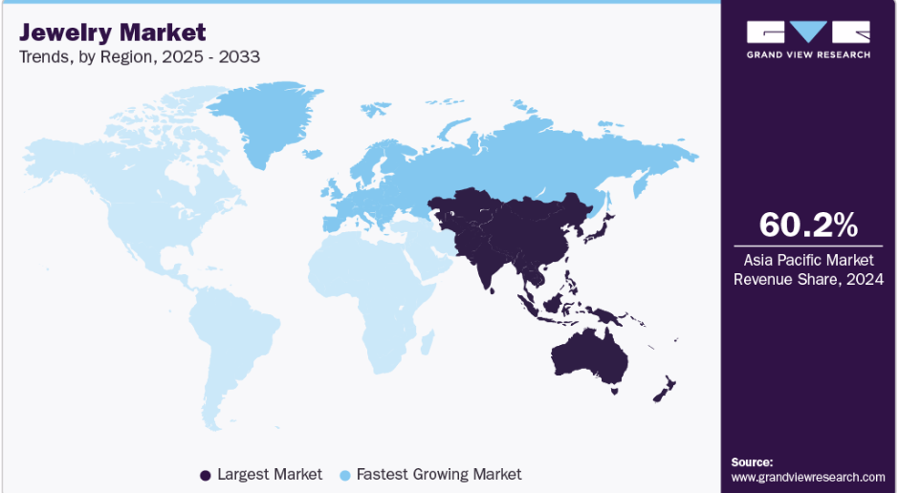
Inventory Management Dashboard
Demand Forecasting:

Slide 7
Predictive Supply Chain Optimization
Problem: Delays & mismatch in regional demand.
DS/ML Solution: Predictive procurement + demand clustering.
SaaS Offering: Supply chain prediction dashboard.
Impact: Optimized supply, reduced dead stock, cost savings.
Summary:
    Our SaaS predicts raw material needs and clusters demand across regions, ensuring smoother procurement and distribution. By aligning supply with real demand, Tanishq avoids overstocking in one area while preventing shortages in another. The solution reduces costs, minimizes waste, and ensures timely delivery, strengthening operational efficiency across the entire jewelry supply chain.

Slide 8
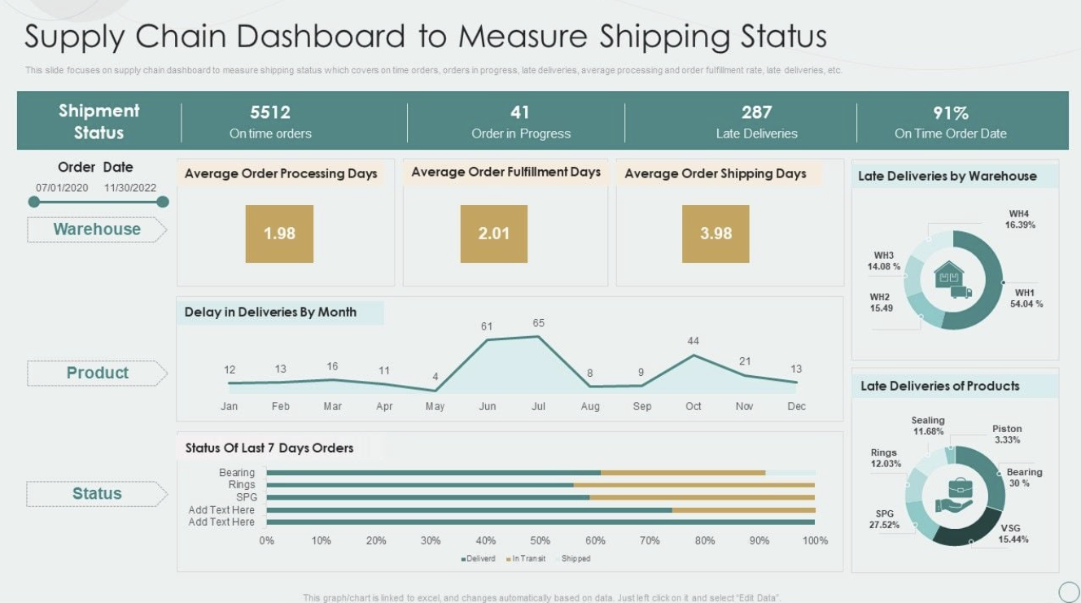
Supply Chain Dashboard

Slide 9
AI-Driven Virtual Stylist
Problem : Personalization today is limited to basic AR try-on; it does not adapt to each customer’s unique shopping history.
DS/ML Solution:
    -Virtual stylist engine integrated with Tanishq CRM.
    -Learns from past purchases, browsing patterns, and Wishlist history.-
    -Uses recommendation algorithms (collaborative + content-based filtering) for hyper- personalized jewellery suggestions.
SaaS Offering:
-Available on website, mobile app, and in-store kiosks.
-Acts as a 24/7 jewelry consultant, guiding customers based on occasion, budget, and style preferences.
Impact:
    -Higher conversions through personalized suggestions.
    -Upselling & cross-selling with “Complete the Look” sets.
    -Luxury experience with recommendations that evolve as customer data grows.
Summary:
Our DS/ML-powered stylist transforms shopping into a curated journey. By analyzing customer purchase history and browsing behavior, it delivers hyper-personalized experiences that increase engagement, strengthen loyalty, and maximize sales uplift.

Slide 10
Dynamic Pricing
Problem: Static pricing despite gold fluctuations & competitor activity.
DS/ML Solution: Reinforcement learning + gold price APIs + competitor monitoring.
SaaS Offering: Dynamic pricing dashboard.
Impact: Real-time optimized pricing, better margins, improved competitiveness.
Summary:
    Our AI engine adjusts jewelry prices dynamically by analyzing live gold rates, competitor pricing, and customer demand signals. This ensures Tanishq stays profitable yet competitive, while boosting conversions during festive or volatile periods.

Slide 11
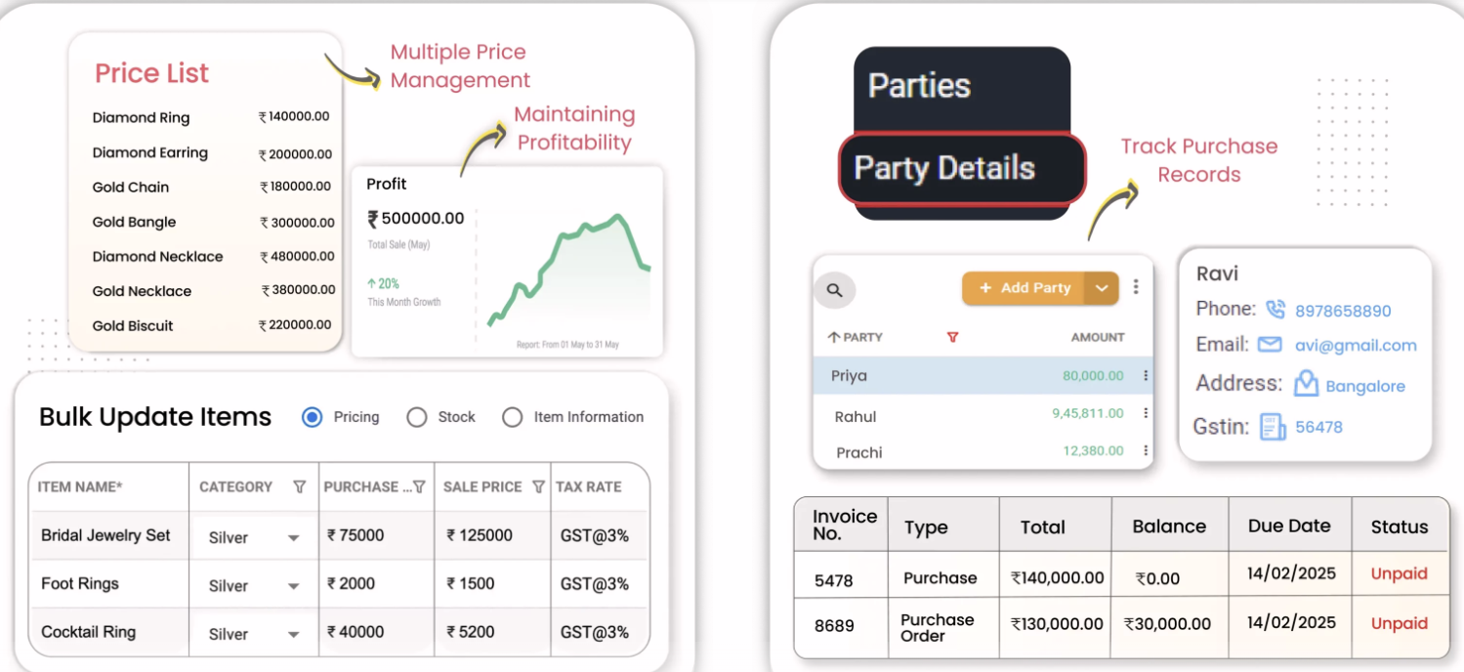
Real time pricing :

Slide 12
Smart In-Store Video Analytics
Problem: No AI-driven insights from CCTV or customer footfall.
DS/ML Solution: Computer vision + heatmaps + behavioral analytics.
SaaS Offering: In-store analytics dashboard.
Impact: Optimized product displays, higher conversion, targeted staffing.
Summary:
    Our AI system turns existing CCTV into business intelligence. It tracks footfall, dwell time, demographics, and hot zones in each store. Managers can identify which collections attract attention but don’t convert, enabling merchandising optimization and sales uplift.

Slide 13
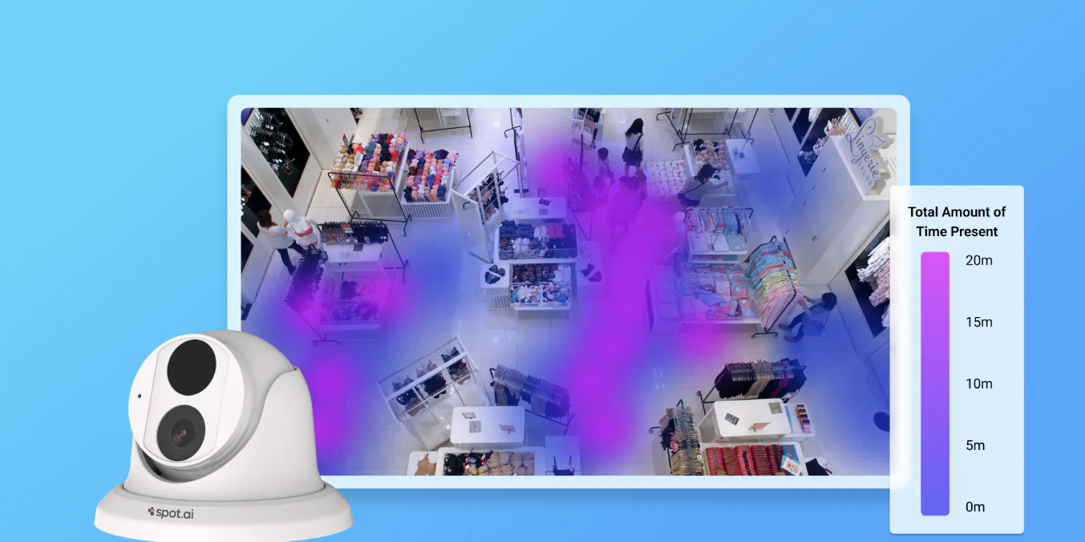
Real time Video Analytics :

Slide 14
Voice-Powered Customer Assistance
Problem: Text-only chatbots limit inclusivity, esp. in Tier-2/3 cities.
DS/ML Solution: Multilingual Voice AI (Hindi, Tamil, Bengali, English).
SaaS Offering: Voice-enabled website, app, and kiosk assistants.
Impact: Broader reach, faster query resolution, inclusivity.
Summary:
    Our SaaS voice assistant allows customers to ask natural questions like “Show me diamond bangles under ₹50,000” in their preferred language. It connects to ERP for live gold rates, stock, and offers. This reduces barriers for non-tech-savvy shoppers and enhances omni-channel engagement.

Slide 15
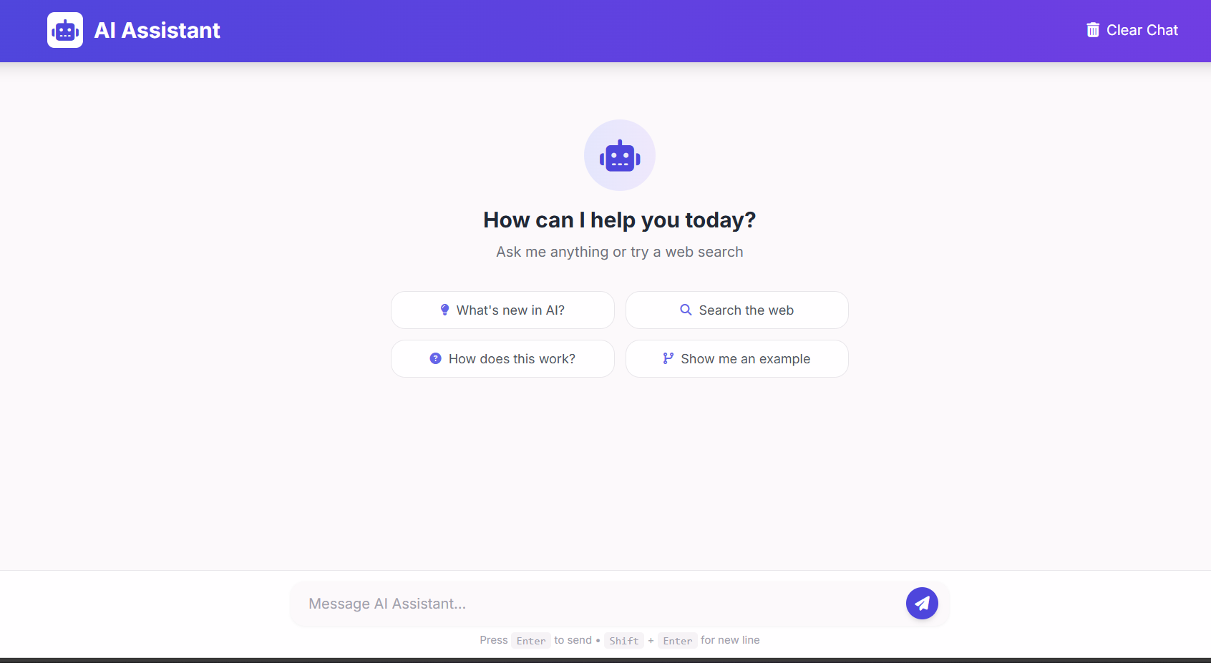
Voice-Powered Customer Assistance:

Slide 16
AI Loyalty & CLV Prediction
Problem: Loyalty programs are static, not predictive.
DS/ML Solution: Churn prediction + CLV scoring + targeted retention.
SaaS Offering: AI loyalty optimization suite.
Impact: Increased customer retention, higher LTV, reduced churn.
Summary:
    Our ML models segment customers into high-value vs at-risk profiles. Tanishq can target exclusive offers, surprise rewards, or early product launches to boost loyalty. Predicting churn saves revenue, while maximizing CLV increases long-term profitability.

Slide 17
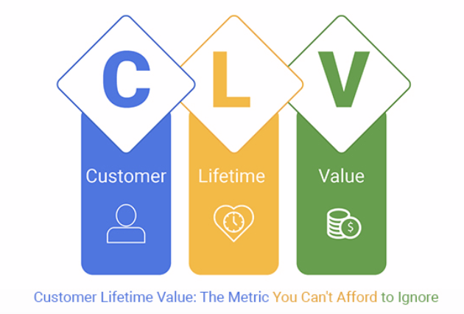
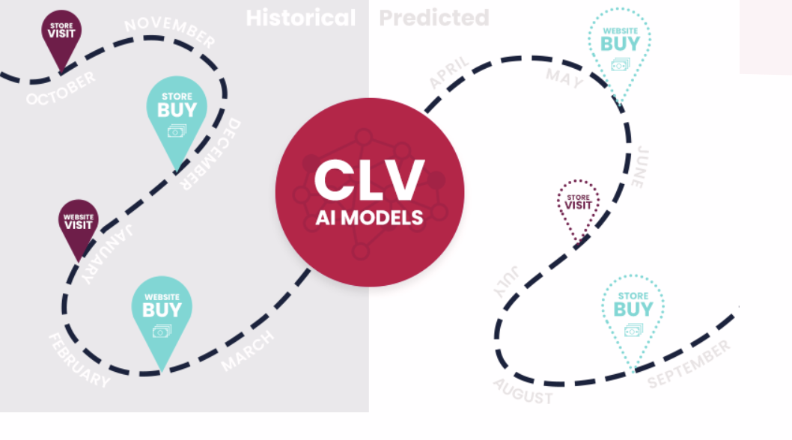

Slide 18
AI Loyalty & CLV Prediction
Problem: Loyalty programs are static, not predictive.
DS/ML Solution: Churn prediction + CLV scoring + targeted retention.
SaaS Offering: AI loyalty optimization suite.
Impact: Increased customer retention, higher LTV, reduced churn.
Summary:
    Our ML models segment customers into high-value vs at-risk profiles. Tanishq can target exclusive offers, surprise rewards, or early product launches to boost loyalty. Predicting churn saves revenue, while maximizing CLV increases long-term profitability.

Slide 19
Fraud & Quality Assurance
Problem : Fake certifications & fraud risks.
DS/ML Solution : Anomaly detection + image recognition.
SaaS Offering : Cloud-based fraud detection SaaS (Python + OpenCV/ML).
Impact : Stronger trust, reduced fraud losses.
Summary :
    Our SaaS solution verifies jewelry authenticity through image recognition and transaction anomaly detection. Every product and sale is checked against certification databases and fraud patterns in real-time. By preventing fake transactions and counterfeit risks, Tanishq strengthens its reputation for trust and ensures customers feel secure in their purchases, reinforcing the brand’s commitment to transparency and authenticity.

Slide 20
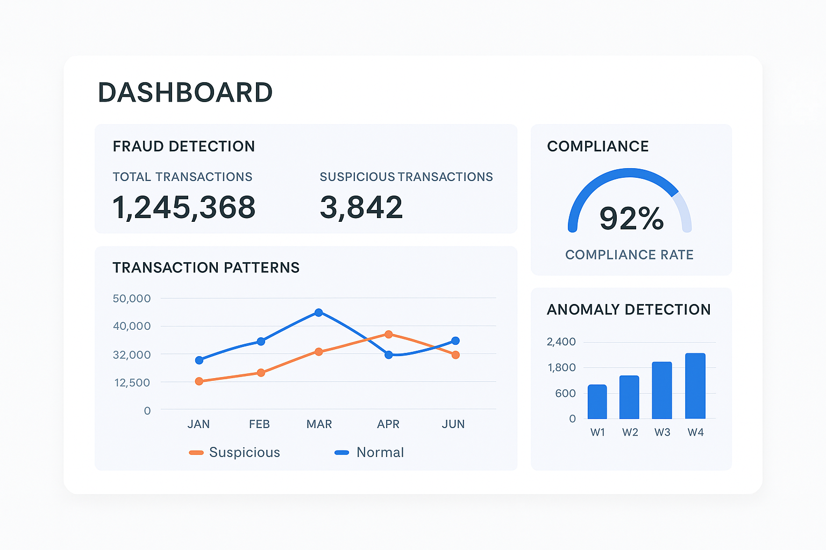
Fraud Detection :

Slide 21
Marketing Efficiency
Problem : Generic campaigns, low ROI.
DS/ML Solution : Customer segmentation & targeting.
SaaS Offering : Campaign optimizer SaaS integrated with CRM.
Impact : Higher ROI, smarter targeting.
Summary :
    Our SaaS segments customers based on buying history, spending behavior, and demographics, then auto-generates personalized campaigns. By targeting the right customers with relevant offers, Tanishq can significantly increase campaign ROI. The system integrates seamlessly with existing CRM tools, enabling data-driven marketing that reduces waste and delivers measurable improvements in sales effectiveness.

Slide 22
Festival & Seasonal Demand
Problem : Seasonal spikes create stock issues.
DS/ML Solution : Time-series forecasting (Prophet/LSTM).
SaaS Offering : Seasonal forecasting SaaS integrated with inventory.
Impact : Boosted festive sales, minimal shortages.
Summary :
    Our SaaS analyzes historical sales data, market trends, and cultural events to predict seasonal demand surges like Diwali, weddings, or Akshaya Tritiya. By preparing inventory ahead of time, Tanishq can maximize festive sales opportunities while minimizing stockouts. This ensures the right designs are available during peak demand, boosting revenue and strengthening customer satisfaction during high-value shopping periods.

Slide 23
Upselling & Cross-Selling
Problem : Missed opportunities to bundle jewelry.
DS/ML Solution : Market basket analysis + cross-sell engine.
SaaS Offering : Checkout recommendation SaaS.
Impact : Higher basket value.
Summary :
    Our SaaS uses market basket analysis to identify jewelry items frequently purchased together. At checkout, the system automatically suggests complementary products such as necklace-earring sets or ring-bracelet combinations. This increases the average order value and enhances customer experience by offering curated bundles that feel personalized and valuable.

Slide 24
Store Performance & Benchmarking
Problem : Lack of visibility into store-level performance compared to competitors and regions.
DS/ML Solution : AI benchmarking models & predictive analytics for regional performance comparison.
SaaS Offering : Store Performance Analytics SaaS with dashboards & alerts.
Impact : Improved decision-making, best-practice adoption, and store-level profitability.
Summary :
    Our SaaS provides benchmarking across regions, formats, and competitor data. Using predictive analytics, it highlights underperforming stores, detects growth opportunities, and recommends best practices. Managers can monitor sales, conversion, and customer satisfaction in real-time, ensuring Tanishq achieves consistent growth, operational efficiency, and stronger market positioning across all locations.

Slide 25
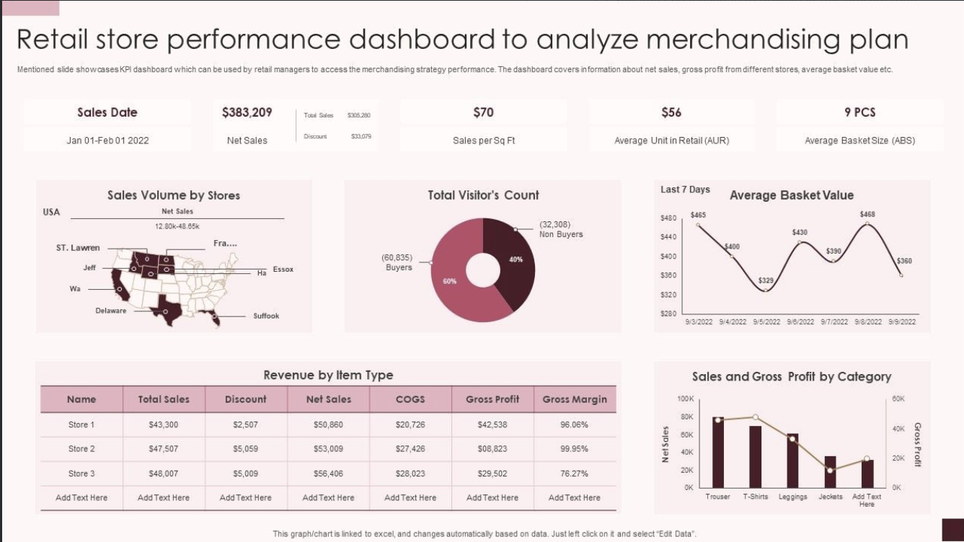
Store Performance & Benchmarking:

Slide 26
Customer Sentiment & Retention
Problem : Difficulty in identifying unhappy customers before they leave.
DS/ML Solution : NLP sentiment analysis on reviews + churn prediction models.
SaaS Offering : Customer Sentiment & Loyalty SaaS.
Impact : Higher retention, stronger brand trust, and reduced churn rate.
Summary:
    Our SaaS captures customer reviews, social media posts, and feedback, applying NLP to detect satisfaction levels in real-time. By combining this with churn prediction, at-risk customers are identified early. Personalized offers, loyalty rewards, and proactive engagement strategies are triggered, improving customer retention and building long-term brand loyalty for Tanishq.

Slide 27
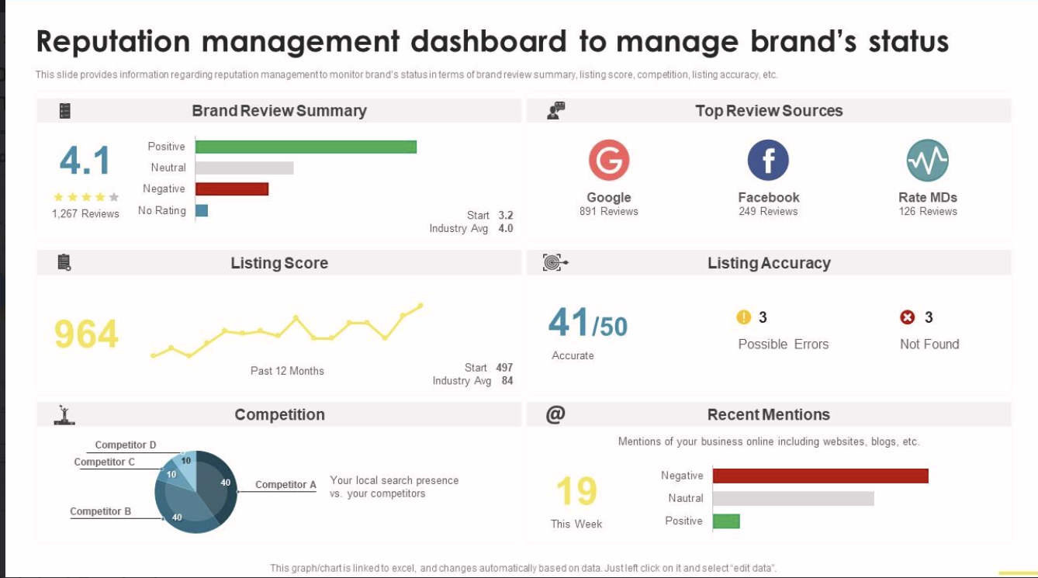
Customer Sentiment & Retention:

Slide 28
Geo-Intelligence for Store Expansion & Marketing
Problem: Expansion decisions lack AI-powered location intelligence.
DS/ML Solution: Geo-clustering + income & festival intensity modeling.
SaaS Offering: Expansion & hyperlocal marketing planner.
Impact: Smarter store expansion, better targeted campaigns, reduced ad waste.
Summary:
    Our AI platform analyzes demographics, income levels, and festival culture to suggest new store locations and run hyperlocal marketing campaigns. This ensures Tanishq is always in the right market at the right time.

Slide 29
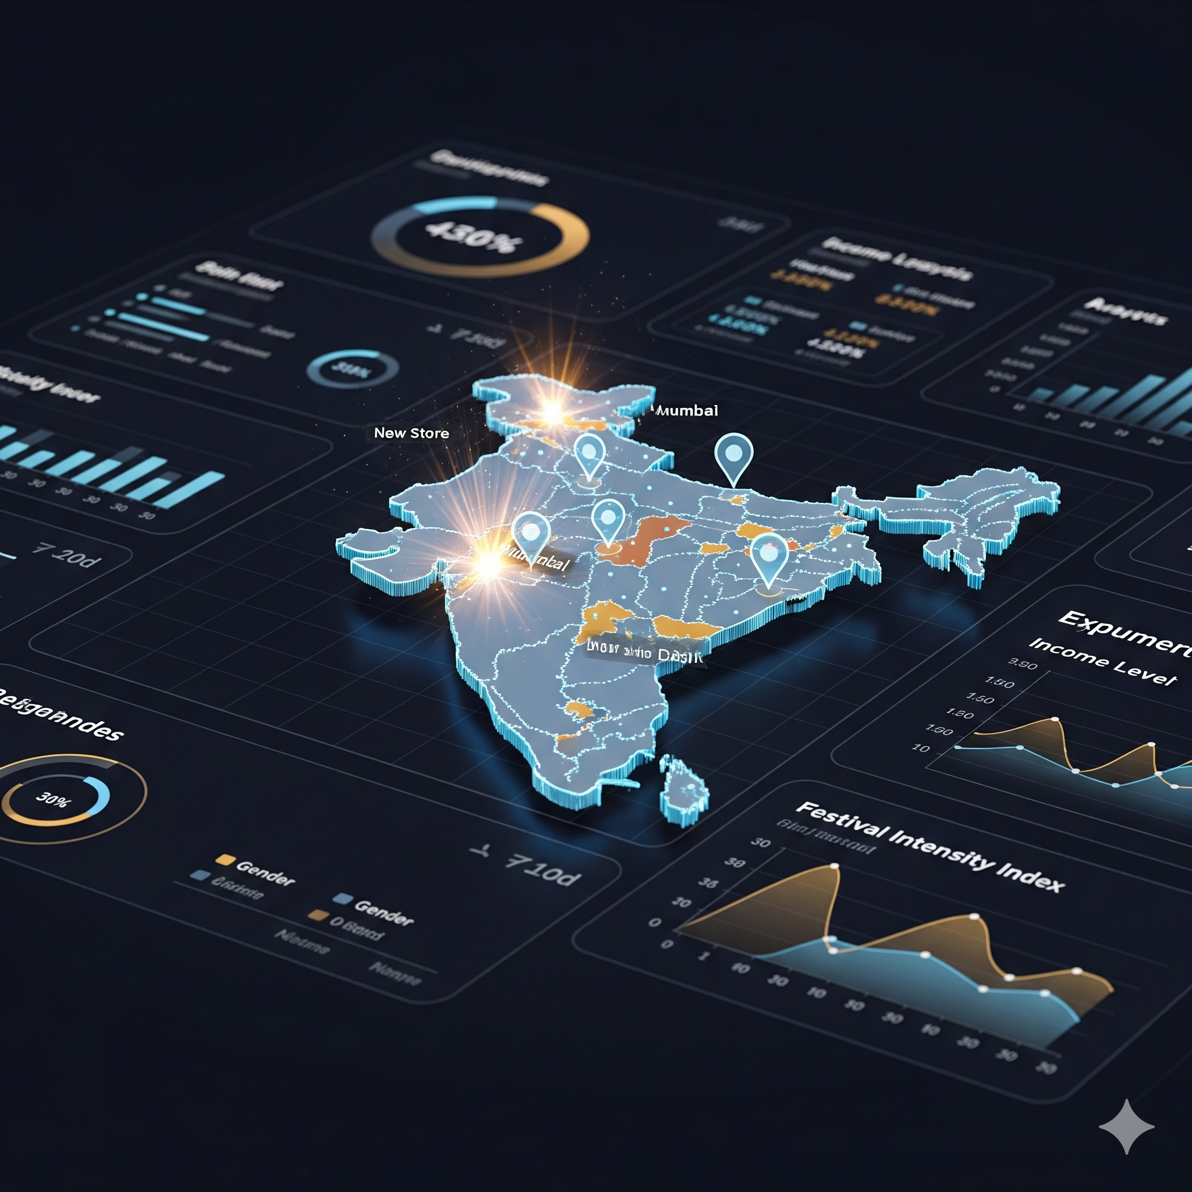
Geo-Intelligence for Store Expansion & Marketing :

Slide 30
Rasa Chatbot for Tanishq
Customer Engagement :
          - 24/7 multilingual support (Website, App)
          - Handles FAQs: gold rates, store info, new collections
Trust & Transparency :
- Provides hallmarking, certification & exchange policy info
Analytics & Insights :
- Tracks customer intents & FAQs → better campaigns & inventory
Impact :
- Rasa chatbot = Enhanced CX + Higher Sales + Stronger Loyalty
- Acts as a digital assistant, freeing staff to focus on premium buyers.
Proof:
Tanishq Utsaah campaign with Meta: 75K+ messages exchanged
- CaratLane & Kalyan Jewellers use AI chatbots for sales uplift

Slide 31
Chatbot UI :

Slide 32
SaaS Productization
AI as SaaS Modules – Transform predictive supply chain, dynamic pricing, AI stylist, and loyalty models into plug-and-play SaaS APIs.
Cross-Platform Integration – Seamless connection with Tanishq’s ERP (Oracle), CRM (Salesforce/Mo-Engage), and digital channels.
AR/Voice Extensions – Deploy AR stylist and Voice AI assistants as cloud-based microservices for web and app.
Scalable Cloud Architecture – Modular SaaS design ensures easy rollout across 400+ stores and international markets.
Unified Intelligence Hub – Centralized SaaS dashboards combining video analytics, store benchmarking, and seasonal demand forecasts.
Faster Innovation Cycles – SaaS delivery enables quick updates, new feature rollouts, and experimentation with minimal IT overhead.
Cost & Efficiency Gains – Reduces infrastructure costs while enabling predictive, real-time decision-making across the value chain.
Summary:
    SaaS-based AI solutions unify Tanishq’s online + offline ecosystem, ensuring personalization, efficiency, and scalability across regions.

Slide 33
Business Impact
Predictive Supply Chain Optimization – Minimizes dead stock, reduces shortages, and lowers logistics costs.
AI Virtual Stylist & AR/Voice Assistants – Drive higher conversions, cross-selling, and an inclusive luxury experience.
Dynamic Pricing Engine – Real-time price optimization boosts margins while staying competitive with gold price shifts.
Smart In-Store Video Analytics – Improves merchandising, staffing, and store layouts for higher customer engagement.
AI-Powered Loyalty & CLV Prediction – Enhances retention, reduces churn, and increases lifetime value per customer.
Seasonal & Festival Demand Forecasting – Ensures availability during peak buying seasons, maximizing festive revenue.
Store Benchmarking & Workforce Optimization – Standardizes performance measurement and improves service quality across regions.
Geo-Intelligence Expansion – Enables data-driven location strategy and hyperlocal marketing campaigns.
Summary:
    SaaS-powered AI ensures Tanishq achieves higher profitability, customer delight, and operational agility—positioning the brand as a global leader in tech-enabled jewelry retail.

Slide 34
Conclusion
Predictive Supply Chain prevents stockouts & reduces dead stock.
AI Virtual Stylist & Voice Assistants deliver personalized shopping.
Dynamic Pricing Engine adapts to gold rates & competitor trends.
Smart In-Store Analytics improves efficiency & customer service.
AI Loyalty & CLV Prediction boosts retention & lifetime value.
SaaS Scalability ensures seamless integration & long-term growth.
Summary:
    SaaS-powered DS/ML drives efficiency, personalization, and profitability, making Tanishq a global leader in tech-driven jewelry retail.

Slide 35
Thank You
FOR YOUR NICE ATTENTION

